Slide 1
Hackathon – 15-Sep-2019
Inceptez Technologies
Venkat M

Slide 2
Problem 1: Credit Score Prediction
Algorithms: Logistic Regression, KNC, SVC and DTC
Metric | Random Forest | Linear Regression | Regularization | Bernoulli NB | RF Regressor | DT | XGB
RMSE | 13.12 | 48.702 | 48.70 | 78.63 | 10.82 | 31.64 | 6.28

Slide 3
Problem 2: Credit Fraud Detection
Methadology: Scaling, Random Undersampling and Oversampling
Correlation, Oversampling with SMOTE
Algorithms: Logistic Regression, KNC, SVC and DTC
Results:
Metric | Logistic Regression | KN Classifier | SVC | Decision Tree Classifier
Accuracy | 94% | 93% | 93% | 91%
Grid Search CV Cross Validation Score | 94.05% | 93.65% | 94.18% | 92.85%
F1 Score No Fraud | 97% | 95% | 96% | 96%
F1 Score Fraud | 96% | 94% | 95% | 95%

Slide 4
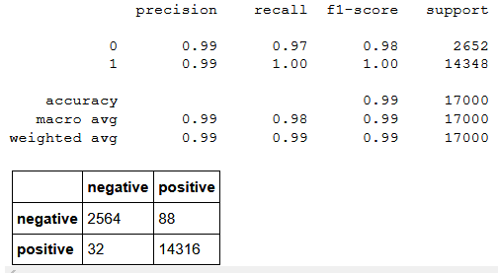
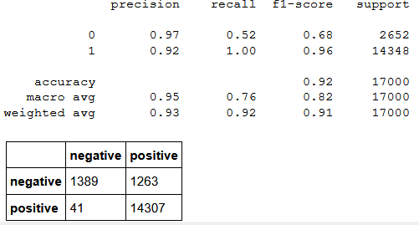
Problem 3: Sentiment Classification
Sentiment_Analysis_Basic_DNN_Models
Logistic Regression with BOW Features
Logistic model with TF-IDF features

Slide 5
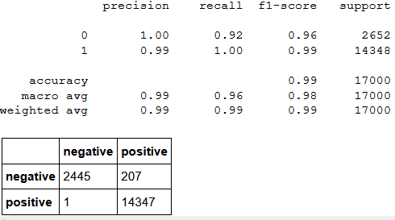
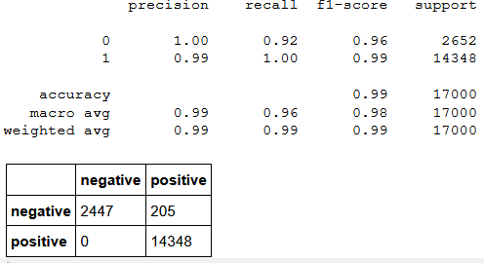
Problem 3: Sentiment Classification
Sentiment_Analysis_Basic_DNN_Models
Random Forest with BOW Features
Random Forest with TF-IDF features

Slide 6
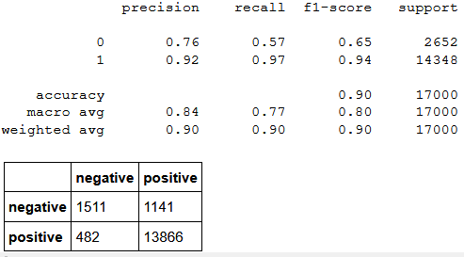
Problem 3: Sentiment Classification
Sentiment_Analysis_Basic_DNN_Models
Model with DNN after feature engineering with word embeddings

Slide 7
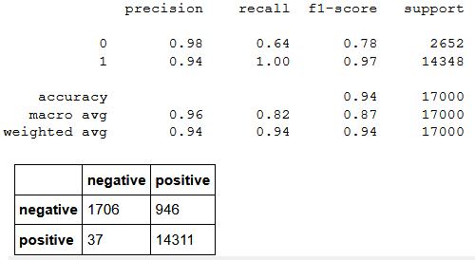
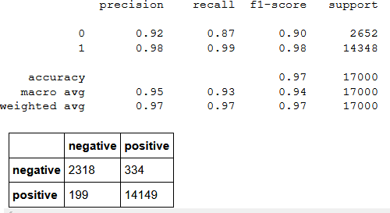
Problem 3: Sentiment Classification
LSTM
Accuracy – 94%
Stacked - LSTM
Accuracy – 97%

